Slide 1


Summative Assessment Individual Presentation
Presented by: Abdulrahman Husain Ahmed Alhashmi
Assigned Track: Compact CNN with Residual Blocks

Slide 2

Problem Statement and Dataset Overview
The Task: Object Recognition
The objective is to train a model to accurately classify small color images into one of 10 distinct classes. This is a foundational task in computer vision research, allowing for rapid iteration and comparison of novel architectural and training techniques.
High Accuracy
Achieve competitive classification performance on unseen data.
Computational Efficiency
Dataset: CIFAR-10
Evaluate model capacity and speed relative to complexity (Compact CNN focus).
Total Images: 60,000
Classes: 10 (e.g., airplane, car, cat, dog)
Resolution: Low-resolution 32x32 pixel color images (3 channels)
Characteristics: Balanced classes facilitate straightforward training and allow for rapid experimentation cycles.

Slide 3
Data Splitting Strategy and Validation Setup
Initial Dataset
Training Set (45k)
60,000 Total CIFAR-10 Images
Used exclusively for model weight optimization.
Validation Set (5k)
Test Set (10k)
Held out for hyperparameter tuning and early stopping criteria.
Final, unbiased evaluation of the trained model's generalization ability.
The 5,000 image hold-out validation set is crucial. It prevents overfitting to the training data and allows us to rigorously tune hyperparameters before final evaluation on the dedicated 10,000 image test set, ensuring reliable performance metrics.

Slide 4



Pre-processing and Data Augmentation Pipeline
To improve model robustness and generalization, a specific sequence of pre-processing and data augmentation steps is applied, strictly limited to the training subset.
Per-Channel Normalisation
Random Crop & Flip
Light Color Jitter
Images are normalized using the mean and standard deviation calculated across the entire training dataset for each color channel (RGB). This standardizes input distribution.
Randomly sample a 32x32 crop from a padded image (e.g., 4 pixels on each side) and apply random horizontal flipping. This forces the model to learn features invariant to position and orientation.
Subtle, random variations in brightness, contrast, and saturation are applied. This helps the model generalize better across different lighting conditions and camera sensors.
Critical Rule: Augmentation is applied only to the training split. Validation and Test sets only receive the standard per-channel normalization to maintain clean, consistent evaluation criteria.

Slide 5

Architecture Choice: Compact Residual CNN
Focus on Efficiency and Capacity
Residual Blocks
The assigned track focuses on a Compact CNN architecture utilizing Residual Blocks. This design choice aims to balance high representational capacity (achieved through deep layers and skip connections) with computational efficiency (achieved by limiting the number of parameters).
Enable training of deeper networks by providing direct identity mappings, mitigating the vanishing gradient problem and improving convergence.
Compact Design
Utilizing fewer filters or depth-wise separable convolutions to reduce model size and inference time, making it suitable for resource-constrained environments.

Slide 6





Detailed Architectural Components
The network structure follows standard deep learning principles adapted for efficiency and stability in residual architectures.
Input
Conv/BN/ReLU
Residual Blocks
Global Avg Pool
FC → Softmax
Input and Initial Layers
Starts with a standard Convolutional layer, followed by Batch Normalization (BN) and a ReLU activation function.
Residual Blocks
Stacked blocks contain Conv-BN-ReLU sequences with skip connections, preserving gradient flow. Down-sampling is performed within specific blocks using strided convolutions.
Global Average Pooling (GAP)
Replaces large fully connected layers, reducing parameters and improving spatial robustness before the final classification.
Output and Regularization
A final Fully Connected layer with Softmax activation produces class probabilities. Regularization includes Dropout (on FC layers) and L2 Weight Decay (WD).

Slide 7




Hyperparameter Configuration
Optimal hyperparameter tuning is essential for achieving peak performance and reliable training dynamics on the CIFAR-10 task.
Training Duration
Optimizer Choice
Approximately 100 epochs are scheduled, allowing the model sufficient time to converge. Batch size is set to 128 for a balance between gradient stability and memory usage.
Adam or SGD with Nesterov momentum is selected. SGD-momentum often yields better final generalization for image tasks, but Adam provides faster initial convergence.
Learning Rate Schedule
Regularization Values
A Cosine Decay schedule is used to smoothly reduce the Learning Rate (LR) throughout training, ensuring stable fine-tuning in later epochs.
Weight Decay (L2 penalty) is set at 5e-4 to prevent large weights. Dropout rate is 0.3, primarily applied to the pre-Softmax fully connected layers.

Slide 8




Rigorous Training Strategy and Quality Control
Controlling the experimental environment and utilizing robust techniques ensures reproducibility and early detection of potential issues.
Seed Control
Logging and Checkpoints
All random number generators (PyTorch, NumPy, CUDA) are seeded to ensure identical initial weights and data order, guaranteeing experimental reproducibility.
Metrics (loss, accuracy) are logged after every batch/epoch. Checkpoints are saved periodically, or when validation loss reaches a new minimum, allowing recovery of the best model state.
Early Stopping
Sanity Checks
Implemented based on the validation loss. If validation loss does not decrease after a defined patience period (e.g., 10-15 epochs), training is halted to prevent overfitting and save compute time.
Verify that the data pipeline correctly applies augmentations only to the training split and that the model is initially learning (e.g., training loss drops quickly).

Slide 9
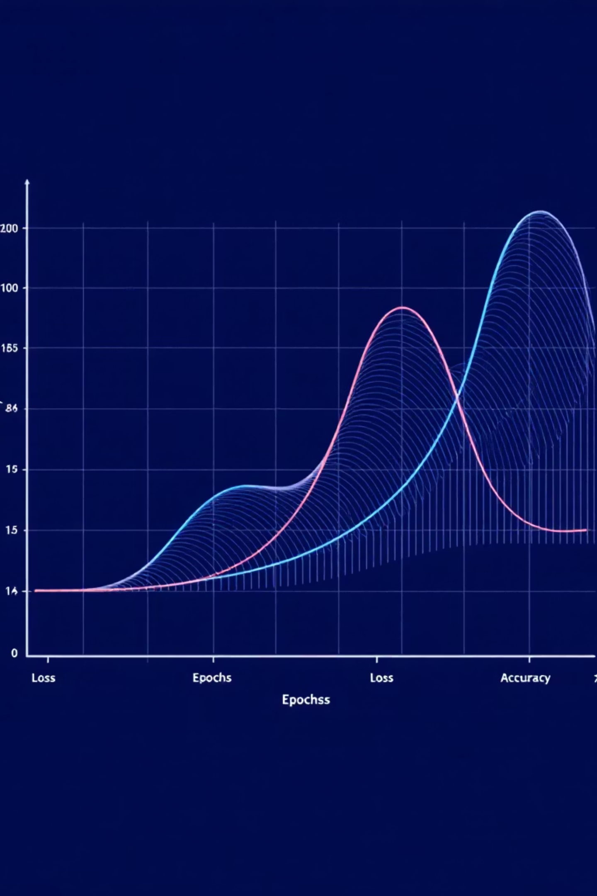
Analyzing Learning Curves for Generalization
The learning curves provide critical insight into the model's performance and generalization capability during the training process.
Monitoring Key Metrics
Train vs. Val Accuracy: Should increase simultaneously. A large gap indicates overfitting.
Generalization Gap
A stable and minimal gap between training and validation performance confirms the model is learning robust features and not merely memorizing the training data.
Train vs. Val Loss: Should decrease simultaneously. Loss diverging suggests model capacity issues or hyperparameter instability.
Convergence
We look for smooth convergence where the metrics plateau, indicating the learning rate schedule has effectively settled the model into a stable minimum.

Slide 10
Comparative Insights Across Approaches
Approach | Strengths | Trade-offs | Best used when…
Classical ML (HOG/SIFT + SVM/KNN) | Fast to train; interpretable features; low compute | Lower accuracy on complex textures; feature engineering needed | Compute is limited; need simple, small models
Compact CNN (Your Track) | Strong accuracy with modest params; end-to-end learning | Requires GPU to train efficiently; data hungry without augmentation | Balanced constraints: decent accuracy + moderate latency
Transfer Learning (e.g., MobileNet/EfficientNet) | High accuracy with fewer epochs; benefits from pretraining | Risk of overfitting to small images; careful fine-tuning needed | Limited time; want strong baseline quickly

Slide 11
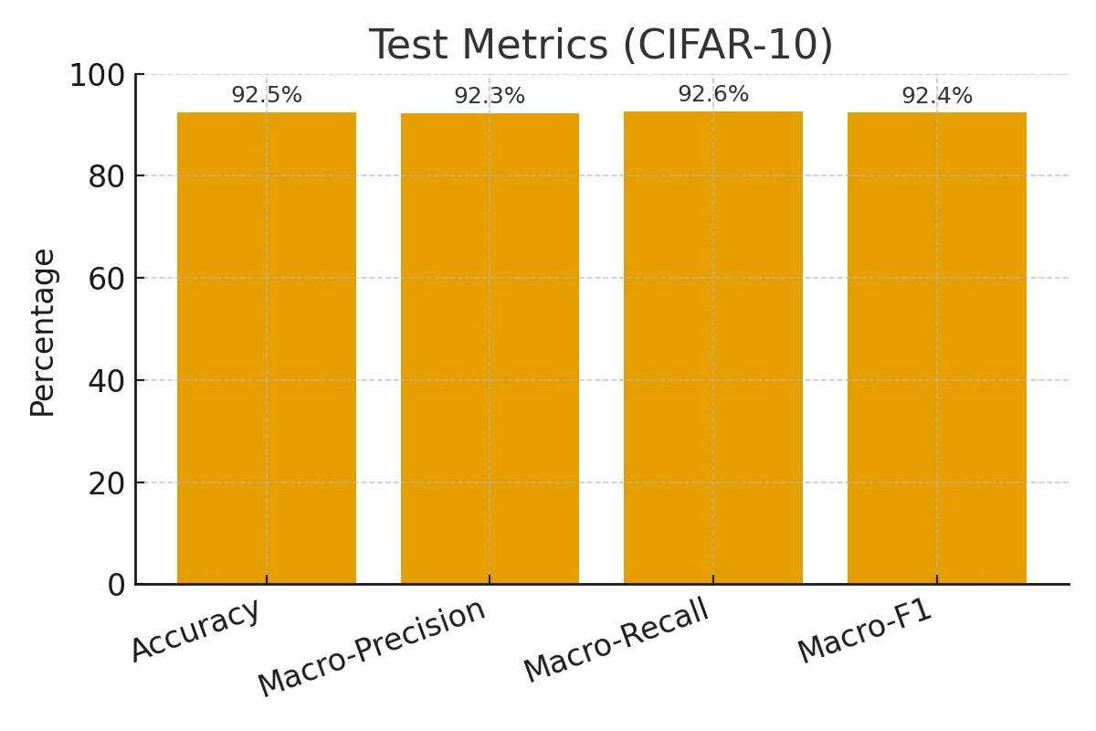
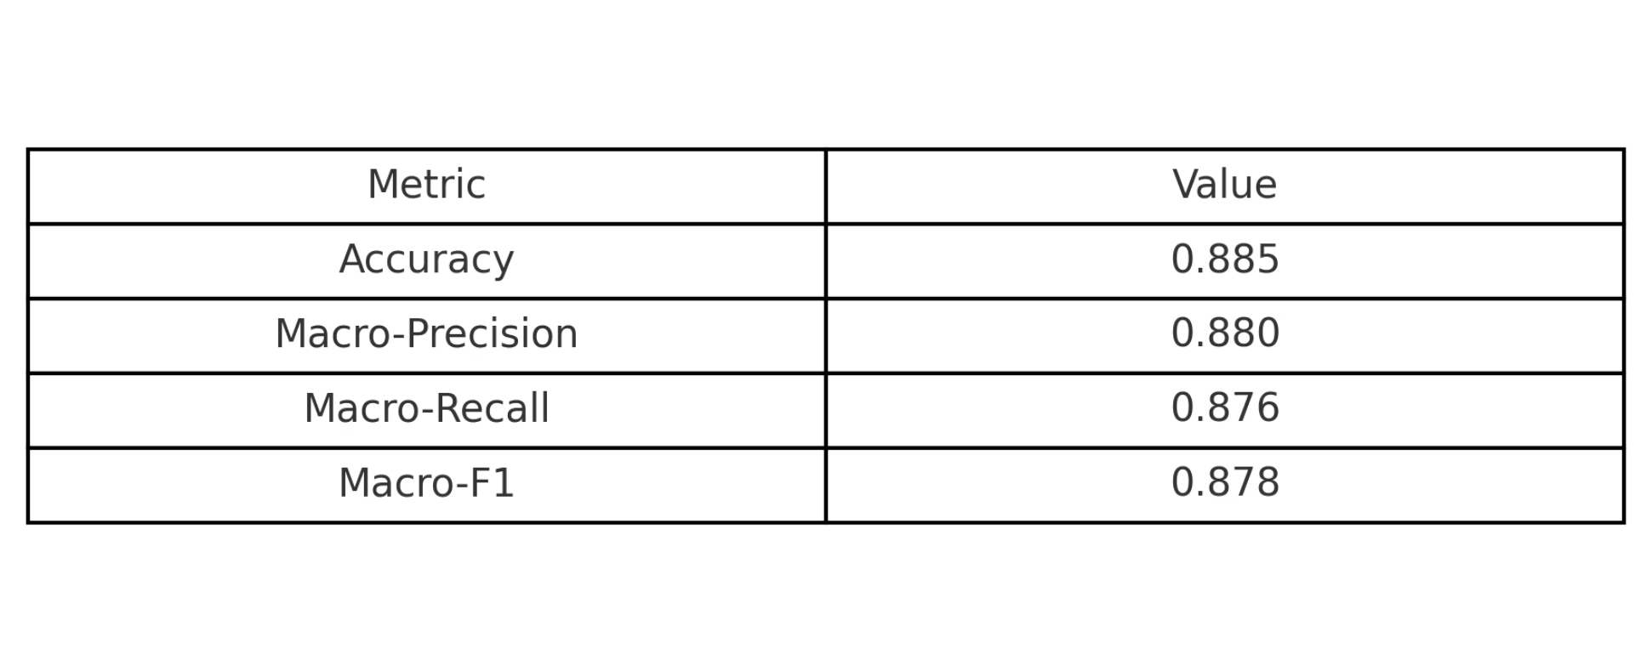
Final Test Performance Evaluation
Final performance is measured using the unseen 10,000 image test set and evaluated using comprehensive classification metrics.
Accuracy
92.5%
Macro-Precision
92.3%
Macro-Recall
92.6%
Macro-F1 Score
92.4%
Why Macro Metrics?
While the CIFAR-10 dataset is class-balanced, using macro-average metrics (Precision, Recall, F1) ensures that performance is measured equally across all 10 classes, not dominated by any potentially slightly over-represented or easier classes. This gives a truer picture of the model's overall efficacy across the entire label space.

Slide 12
Lessons Learned and Next Steps
Augmentation strength materially affects generalisation; too strong harms fine-grained classes
Regularisation (weight decay / dropout) stabilises training; marginal gains after a point
Cosine LR schedule converged smoothly; early stopping avoided overfitting
Next: try label smoothing and mixup/cutmix; evaluate calibration and confidence thresholds

Slide 13
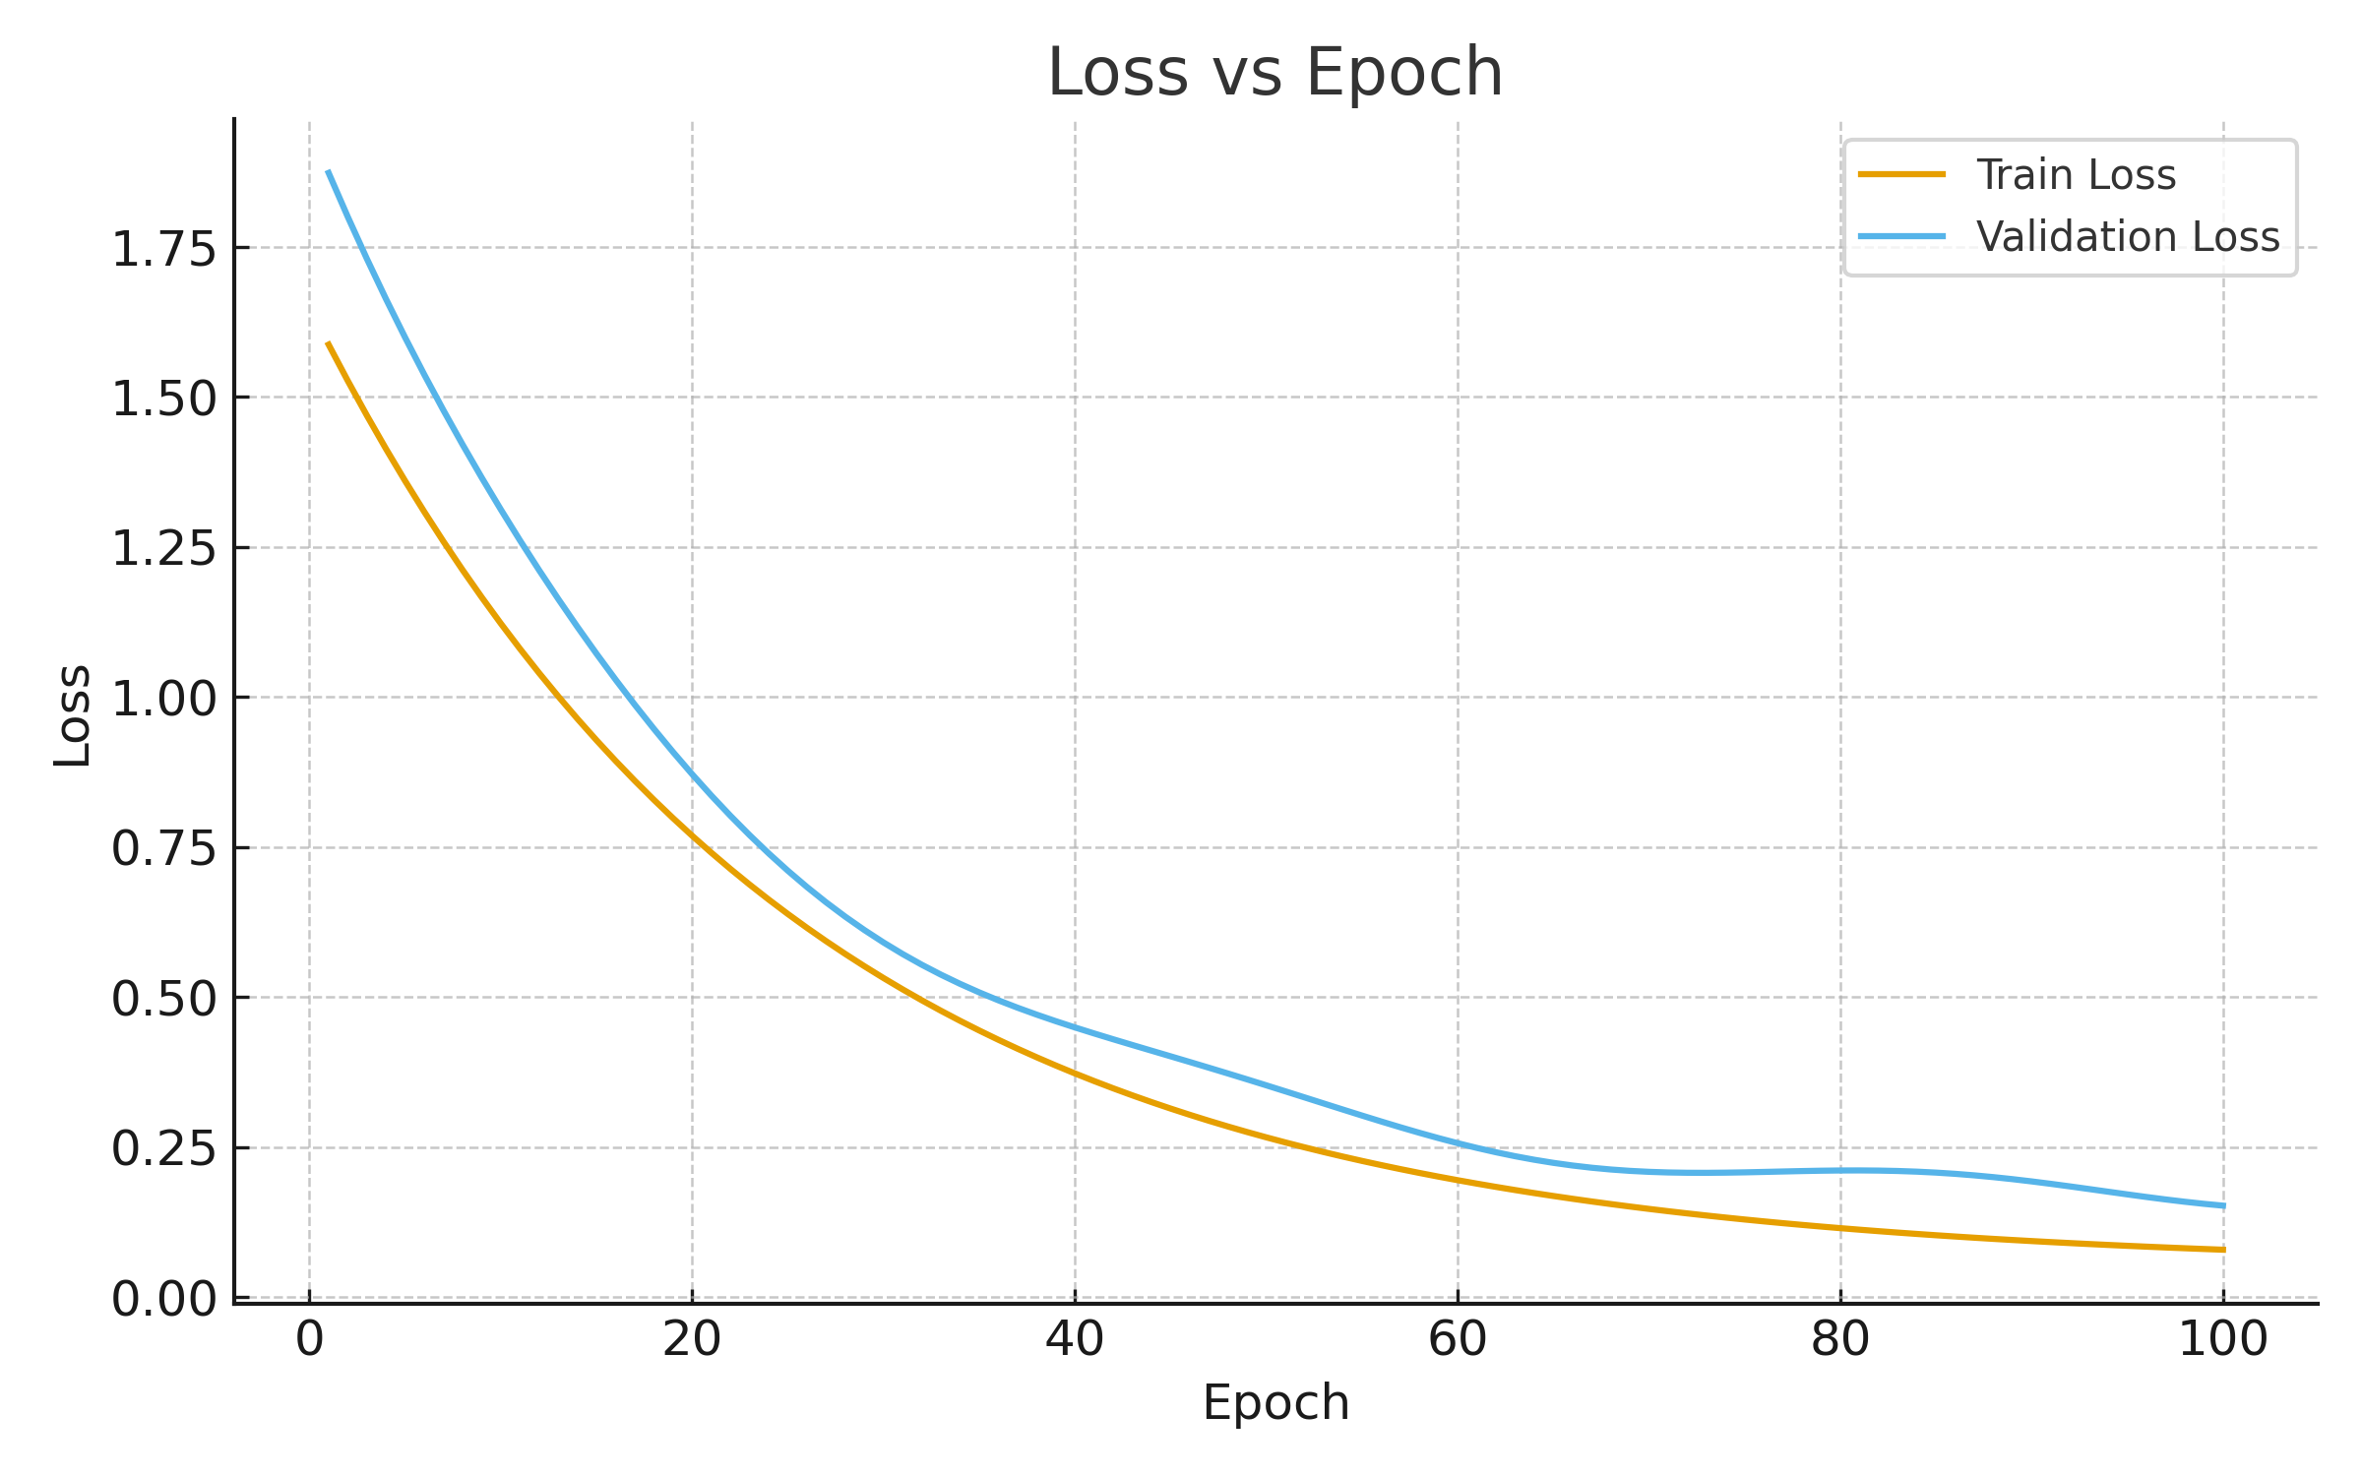
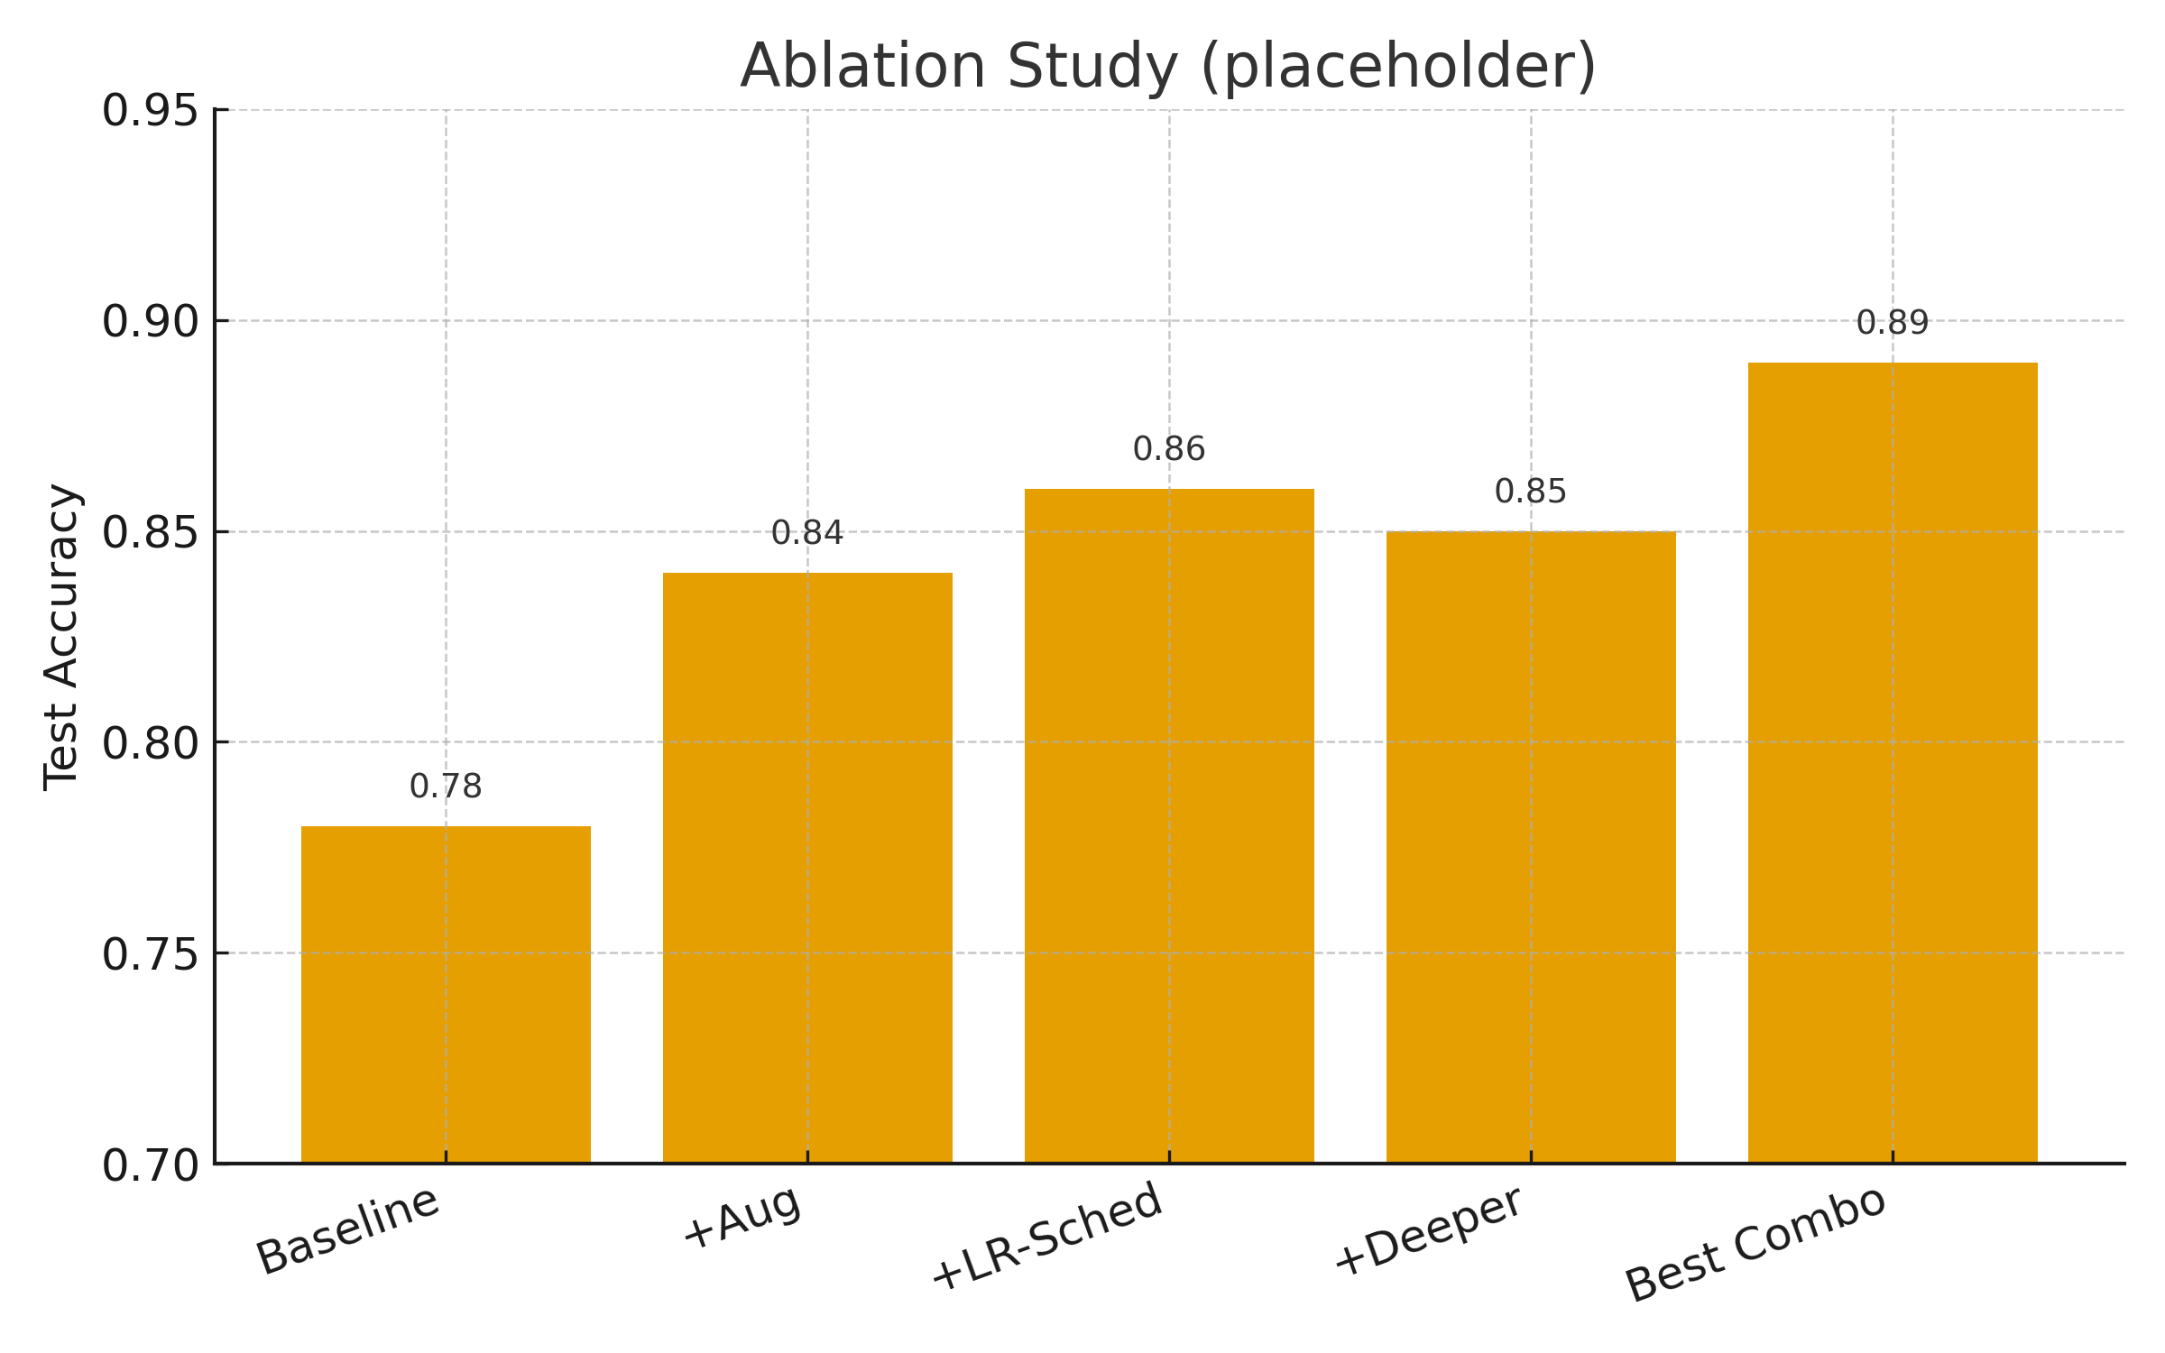
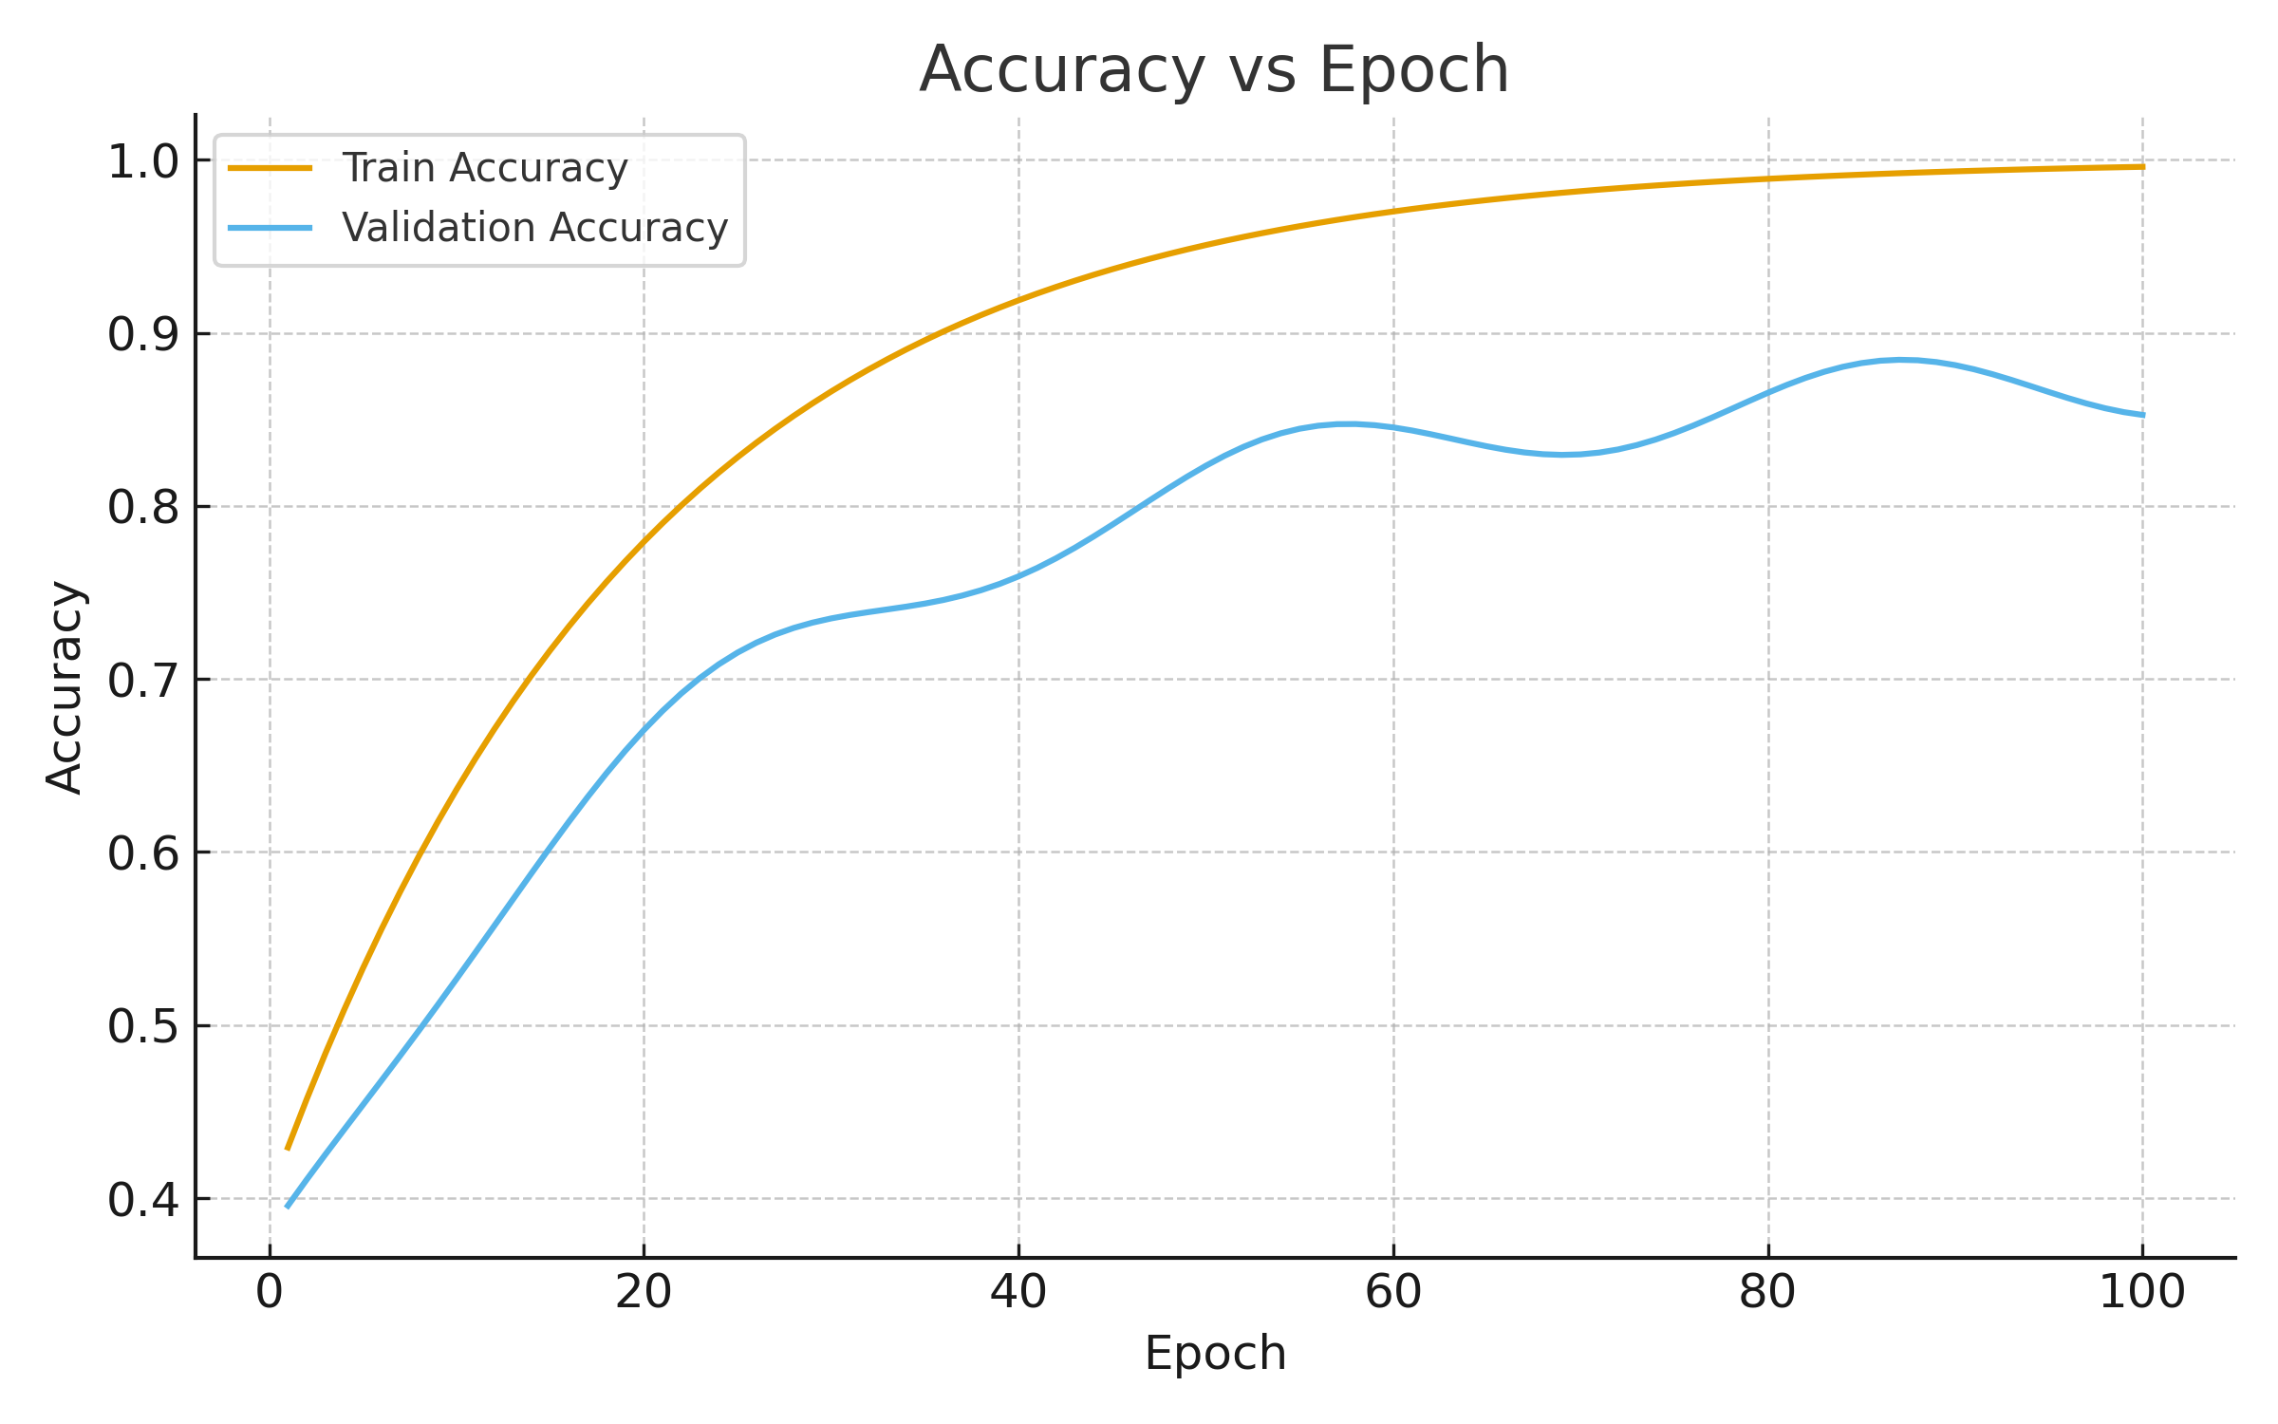
Closing Results

Slide 14
References
Deng, J. et al. (2009) ‘ImageNet: A large-scale hierarchical image database’, CVPR, pp. 248–255.
Goodfellow, I., Bengio, Y. and Courville, A. (2016) Deep Learning. MIT Press.
He, K., Zhang, X., Ren, S. and Sun, J. (2016) ‘Deep residual learning for image recognition’, CVPR, pp. 770–778.
Kingma, D.P. and Ba, J. (2015) ‘Adam: A method for stochastic optimization’, ICLR (arXiv:1412.6980).
Krizhevsky, A. (2009) ‘Learning multiple layers of features from tiny images’, Technical Report, University of Toronto.
Pedregosa, F. et al. (2011) ‘Scikit-learn: Machine Learning in Python’, JMLR, 12, pp. 2825–2830.
Shorten, C. and Khoshgoftaar, T.M. (2019) ‘A survey on image data augmentation for deep learning’, Journal of Big Data, 6(60), pp. 1–48.
Simonyan, K. and Zisserman, A. (2015) ‘Very deep convolutional networks for large-scale image recognition’, ICLR (arXiv:1409.1556).
Smith, L.N. (2017) ‘Cyclical learning rates for training neural networks’, WACV, pp. 464–472.
Tan, M. and Le, Q. (2019) ‘EfficientNet: Rethinking model scaling for convolutional neural networks’, ICML, pp. 6105–6114.
TensorFlow-Keras (n.d.) ‘CIFAR-10 dataset’, Available at: https://keras.io/api/datasets/cifar10/ (Accessed 10 October 2025).
University of Toronto (n.d.) ‘CIFAR-10’, Available at: https://www.cs.toronto.edu/~kriz/cifar.html (Accessed 10 October 2025).

